Slide 1
PROJECT PROPOSAL · DATA MINING PIPELINE
Predictive Maintenance for
Metro Climate & Air Systems
Contextual anomaly detection on 1.5M sensor readings from a metro Air Production Unit
Joseph (Neil) Truskolaski
Department of Data Science · University of Colorado Boulder
Dataset: MetroPT-3 (UCI ML Repository) · Porto Metro APU · Feb–Sep 2020
1,516,948
15
213
4
readings
sensors
days
logged failures

Slide 2
Why This Matters
2
A compressor fault reaches passengers long before it reaches a workshop.
1
An unplanned APU failure strands a train mid-line. Recovery is measured in hours, not minutes, and cascades across the timetable.
Service reliability
2
The APU supplies the pneumatic circuit behind climate control, doors and suspension. Air loss degrades cabin conditions before anyone reports a fault.
Passenger comfort
3
In the four logged failures the compressor ran under load 99.6% of the time versus 14.6% normally, a ~6.8x increase in duty cycle, and a correspondingly large increase in energy drawn.
Energy cost
4
Calendar-based servicing either replaces healthy parts or arrives late. Condition-based scheduling targets the intervention window instead.
Maintenance economics
Problem statement: given only unlabelled multivariate sensor streams, detect degradation of the air production unit early enough and precisely enough to act on.

Slide 3
Related Work and the Gap
3
Research on this dataset converges from several directions. None of them closes it.
Physics & rule-based
HVAC diagnostics
Deep anomaly detection
on APU data
Streaming & explainable
PdM
ASHRAE RP-1043 style residual checks and expert rules.
Davari et al. (2021) apply sparse autoencoders and LSTM-AE to this exact unit.
Barros et al. (2020) and Gama et al. (2022) on drift-aware online detection.
Strong interpretability, but thresholds are tuned per unit and do not transfer across duty cycles.
Reconstruction error flags the event, but offers little on why, and evaluation is largely per-sample.
Method-focused. Cycle-level structure of the compressor is left on the table.
The gap this project fills
Prior work treats each reading as the unit of analysis. This project treats the compression cycle as the unit of analysis, then evaluates on an event basis with an explicit lead-time budget.
The contribution is a reproducible, cycle-aware baseline that reports precision at a fixed alert budget, not per-sample accuracy on an imbalanced stream.

Slide 4
The Data: Four V's
4
Profiled directly from the source file, not from the dataset card.
VOLUME
readings x 15 sensors = 22.8M values, 208 MB raw CSV covering 213 consecutive days.
VARIETY
Seven analogue channels (bar, °C, A) and eight digital state flags. Mixed types, one clock.
1,516,948
7 + 8
VELOCITY
One reading every 10s, 8,640 per day. Batch now, but sized for a streaming deployment.
VERACITY
of rows are frozen across all analogue channels; pressures read slightly negative at rest.
0.1 Hz
3.35%
Veracity findings that shape the whole pipeline
TP3 and Reservoirs are perfectly collinear (r = 1.00), so one is redundant.
Only 1.98% of rows fall inside a reported failure window, which is severe class imbalance.
331 timing gaps exceed 60s, the largest 48 hours, so the clock is not uniform.
Labels are event reports, not annotations: unlabelled high-load episodes exist (see next slide).

Slide 5
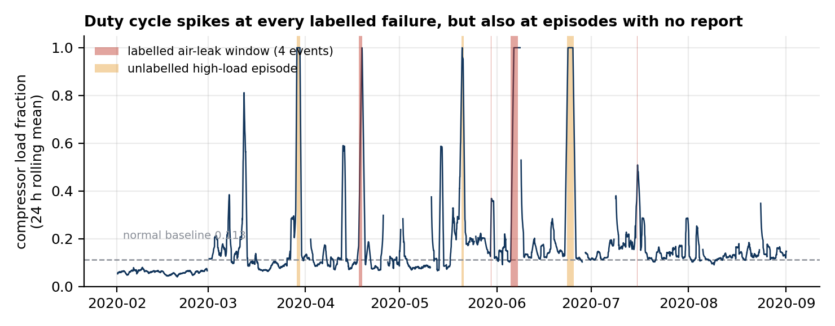
What Exploration Already Shows
5
The signal is real. So is the hard part.
Read this way
Every labelled failure sits on a duty-cycle spike. The physics is visible.
But several equally large spikes carry no failure report at all.
A naive threshold detector therefore reaches recall 0.66 at precision 0.21, giving F1 of 0.32.
6.8x
0.32
75%
36-62h
duty cycle inside
failure windows
F1 of the naive
threshold baseline
of high-load hours
have no report
precursor lead time
in 2 of 4 events
Implication: the modelling problem is not detection, it is discrimination, separating leak-driven load from demand-driven load.

Slide 6
Methodology: The Whole Pipeline
6
Five stages, each with a stated decision and a stated reason.
01
02
03
04
05
Data
Understanding
Pre-processing
Management
Modeling
Evaluation
Distributions, ACF, duty-cycle profiling, correlation and PCA. Establishes the normal operating envelope before any model is fit.
Resample to a uniform 10s grid, gap-flag rather than interpolate, median filter analogue channels, debounce digital flags.
Reduce 1.5M rows to ~16.9k compression cycles in columnar Parquet, partitioned by month. 90x smaller, physically meaningful.
Three tasks: clustering for normal states, semi-supervised anomaly detection, supervised classification with lead-time labels.
Event-level precision and recall at a fixed alert budget, plus throughput on the full 1.5M-row stream.
→
→
→
→
Key design decision: the compression cycle, not the 10-second reading, is the unit of analysis. A leak does not change any single reading much; it changes how long the compressor must run to refill the reservoir. Cycle-level features make that directly measurable.

Slide 7
Three Modeling Tasks, Three Purposes
7
Chosen because the label situation demands all three, not because more is better.
Clustering
Discovers the operating regimes without labels. Answers: how many distinct 'normal' modes does this unit actually have? Silhouette and Davies-Bouldin select k.
1
K-means and DBSCAN on cycle features
Anomaly detection
Trained on February–March only, where no failure is reported. Everything after is scored as deviation. Chosen because labels are scarce and possibly incomplete.
2
Isolation Forest and LSTM autoencoder
Classification
Labels each cycle by hours-to-failure. Answers the operational question: can we call it 24 hours out? Gives calibrated probabilities and SHAP attribution.
3
Gradient boosting with lead-time labels
Why not go straight to deep learning? Because a tuned Isolation Forest on 40 cycle features that beats F1 = 0.32 is a defensible result. An LSTM that beats it without an interpretable baseline to compare against is not.

Slide 8
Evaluation Plan
8
Accuracy is the wrong metric here. This slide says what replaces it.
Effectiveness
Efficiency
Precision, recall, F1, PR-AUC. Not accuracy: 'always normal' scores 98.0%.
Event-level detection: caught if any alarm fires in the window.
False alarms per 30 days at a fixed alert budget.
Mean lead time before failure onset, reported with its variance.
End-to-end wall clock over all 1,516,948 rows, per stage.
Throughput in readings/second and peak memory, on fixed hardware.
Per-cycle scoring latency, well under the ~18 min cycle interval.
Training time and model size, for the edge-deployment question.
Experimental setup
Chronological split, never random. Feb- Mar trains, Apr - Sep tests. Feb- Mar is the longest stretch with no reported failure, which is the whole point: the detector must learn normality from clean data.
Blocked K-fold (k = 5) with a purge gap. Folds are contiguous time blocks separated by a 24h purge window so no cycle straddles a boundary. Standard K-fold is invalid on time series.
Baselines to beat: the naive duty-cycle threshold (F1 = 0.32) and a seasonal-naive persistence model. Any proposed method must beat both to justify its complexity.

Slide 9
Timeline
9
21 June to 15 August 2027, with the risky work deliberately placed early.
W1 21-27 Jun
W2 28 Jun-4 Jul
W3 5-11 Jul
W4 12-18 Jul
Profiling & EDA
Cleaning & feature store
Clustering & regimes
Anomaly detection
Distributions, ACF, regime characterisation, cycle segmentation validated by hand.
Uniform grid, gap flags, filtering. Parquet cycle table locked and versioned.
K-means / DBSCAN, k selected. Deliverable: labelled operating-mode map.
Isolation Forest baseline on clean-window training. First event-level scores.
W5 19-25 Jul
W6 26 Jul-1 Aug
W7 2-8 Aug
W8 9-15 Aug
Supervised models
Efficiency benchmarking
Ablations & writing
Buffer & delivery
Lead-time labelling, gradient boosting, blocked CV, SHAP attribution.
Throughput, latency and memory on the full stream. LSTM autoencoder comparison if schedule allows.
Ablations, sensitivity to the alert budget, consolidate results, draft report.
Reserved for overrun. Final report, deck and reproducible repository.
Weeks 1 and 2 are load-bearing: if cycle segmentation is wrong, every downstream result is wrong. Week 8, the week of 9 August, is unallocated on purpose.

Slide 10
Expected Outcome
What a supervisor will be able to see at the end of week eight.
1
A working detector
2
A defensible baseline
Cycle-level anomaly scores for all 213 days, with event-level precision, recall and lead time reported against the four documented failures.
A published comparison against the naive threshold (F1 = 0.32) so any gain is attributable to method, not to metric choice.
3
An explanation, not just a flag
4
A reproducible artefact
SHAP attribution naming which sensors drive each alarm, which is the difference between an alert and an actionable work order.
Versioned Parquet feature store, seeded notebooks and benchmark scripts that rerun end to end on the full 1.5M rows.
If the primary approach fails, the fallback is a change-point detector on the duty-cycle series alone. It is weaker, but it is guaranteed to produce a result.
Joseph (Neil) Truskolaski · MetroPT-3 Predictive Maintenance Proposal

